Slide 1
CUSTOMER INSIGHTS / GROWTH LEVERS / 2026
CUSTOMER
SHOPPING
BEHAVIOR
AN EVIDENCE FILE ON REVENUE, LOYALTY, SUBSCRIPTIONS, DISCOUNTS, PRODUCTS, AND TARGETING.

Slide 2
CASE FILE / SHOPPING BEHAVIOR
CUSTOMER SHOPPING BEHAVIOR
01 / DATASET
THE DATASET IS BROAD ENOUGH TO FIND GROWTH SIGNALS.
3,900
18
25
purchases
columns
products · 50 locations
Four product categories
Clothing, Accessories, Footwear, and Outerwear.
Average purchase $59.76
Average review rating 3.75
DATA QUALITY: 37 review ratings were missing and imputed by product-category median.
CUSTOMER INSIGHTS
GROWTH LEVERS / 2026
02 / 10

Slide 3
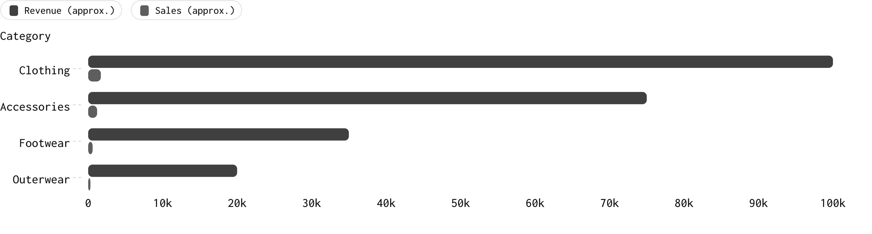
CASE FILE / SHOPPING BEHAVIOR
CUSTOMER SHOPPING BEHAVIOR
02 / CATEGORY PERFORMANCE
CLOTHING CARRIES THE REVENUE.
Clothing leads both revenue and sales.
Revenue and sales by category · approximate dashboard values. Revenue and sales are shown on separate series scales by the chart engine.
CUSTOMER INSIGHTS
GROWTH LEVERS / 2026
03 / 10

Slide 4
CASE FILE / SHOPPING BEHAVIOR
CUSTOMER SHOPPING BEHAVIOR
03 / CUSTOMER BASE
THE CUSTOMER BASE IS ALREADY LOYAL.
3,116
701
83
LOYAL
RETURNING
NEW
Customers
Customers
Customers
The customer base is already weighted toward loyalty. The clearest growth question is how to move returning customers into the loyal segment.
CUSTOMER INSIGHTS
GROWTH LEVERS / 2026
04 / 10

Slide 5
CASE FILE / SHOPPING BEHAVIOR
CUSTOMER SHOPPING BEHAVIOR
04 / SUBSCRIPTION
THE SUBSCRIPTION GAP IS THE CLEAREST GROWTH LEVER.
SUBSCRIBERS
NON-SUBSCRIBERS
1,053
2,847
27% of the base
73% of the base
$62,645 total revenue
$59.49 average spend
$170,436 total revenue
$59.87 average spend
Average spend is nearly identical. The opportunity is conversion and retention rather than a higher-ticket subscriber basket.
CUSTOMER INSIGHTS
GROWTH LEVERS / 2026
05 / 10

Slide 6
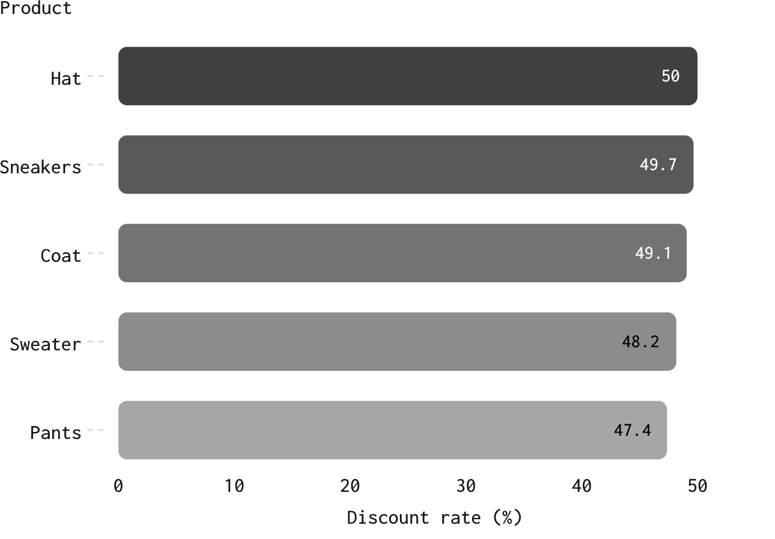
CASE FILE / SHOPPING BEHAVIOR
CUSTOMER SHOPPING BEHAVIOR
05 / DISCOUNTING
DISCOUNTS CAN DRIVE VALUE WITHOUT OWNING THE MARGIN.
839
customers used discounts while spending above the average purchase amount.
Discount policy should be reviewed by product and customer value, not as a blanket promotion.
Highest discount rates · exact values shown.
CUSTOMER INSIGHTS
GROWTH LEVERS / 2026
06 / 10

Slide 7
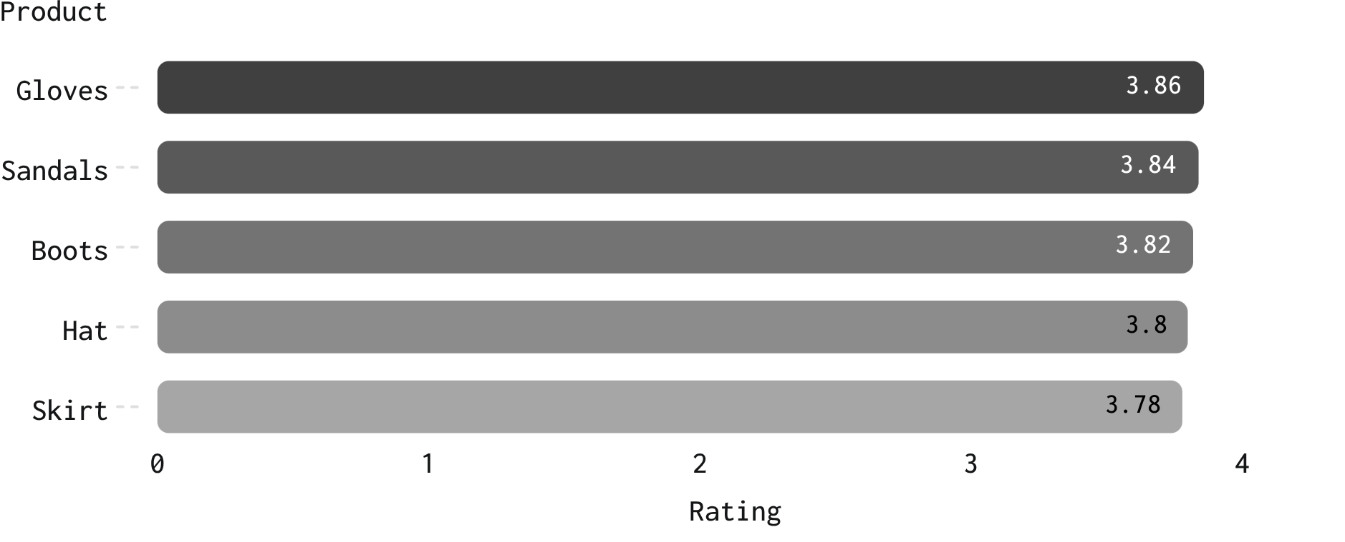
CASE FILE / SHOPPING BEHAVIOR
CUSTOMER SHOPPING BEHAVIOR
06 / PRODUCT SIGNALS
TOP-RATED PRODUCTS GIVE CAMPAIGNS A PROVEN STARTING POINT.
Top product by category | Orders
Jewelry | 171
Blouse | 171
Jacket | 163
Sandals | 160
Position high-rated and high-volume products together in campaigns.
Top five by rating.
CUSTOMER INSIGHTS
GROWTH LEVERS / 2026
07 / 10

Slide 8
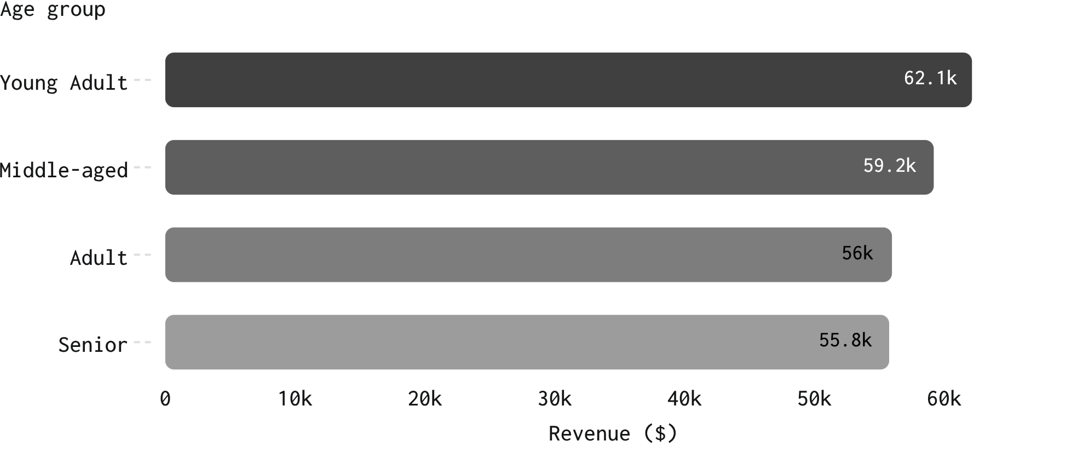
CASE FILE / SHOPPING BEHAVIOR
CUSTOMER SHOPPING BEHAVIOR
07 / AUDIENCE TARGETING
YOUNG ADULTS LEAD REVENUE, BUT EVERY AGE GROUP MATTERS.
REVENUE BY GENDER
Gender | Revenue
Male | $157,890
Female | $75,191
Young Adults lead revenue, while every age group matters.
CUSTOMER INSIGHTS
GROWTH LEVERS / 2026
08 / 10

Slide 9
CASE FILE / SHOPPING BEHAVIOR
CUSTOMER SHOPPING BEHAVIOR
08 / SHIPPING SIGNAL
EXPRESS SHIPPING SIGNALS A SLIGHTLY HIGHER-VALUE ORDER.
Repeat buyers with more than five purchases | Customers
Subscribers | 958
Non-subscribers | 2,518
EXPRESS
STANDARD
$60.48
$58.46
Average purchase
Average purchase
Use shipping preference as a targeting signal alongside age, product, and subscription status.
CUSTOMER INSIGHTS
GROWTH LEVERS / 2026
09 / 10

Slide 10
CASE FILE / SHOPPING BEHAVIOR
CUSTOMER SHOPPING BEHAVIOR
09 / ACTION PLAN
THE ACTION PLAN IS CLEAR.
01
02
03
04
Boost subscriptions
Reward repeat buyers
Protect margin
Target proven demand
Refine discounting by product and customer value.
Create exclusive benefits for the loyal base.
Move returning customers toward loyalty.
Lead with high-rated products, high-revenue age groups, and express-shipping users.
CUSTOMER INSIGHTS
GROWTH LEVERS / 2026
10 / 10

